Slide 1

Pressure Sensor
Sayed Asad Shah 6217000162
Qamber Abbas 6217000198

Slide 2
Pressure Sensor
Pressure
Pressure is defined as the applied force by a liquid or gas on a surface and it is usually measured in units of force per unit of surface area. Common units are Pascal (Pa), Bar (bar), N/mm2 or psi (pounds per square inch).
Sensor
A sensor is a device that measures a physical quantity and translates it to a signal. The quantity can be for instance temperature, length, force, or – of course – pressure. The signal is in most cases electrical but can also be optical.

Slide 3
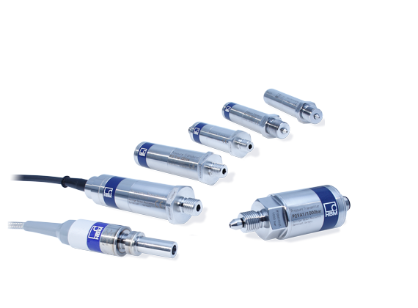
Pressure Sensor
Pressure Sensor
pressure sensor is an instrument consisting of a pressure sensitive element to determine the actual pressure applied to the sensor (using different working principles) and some components to convert this information into an output signal.

Slide 4
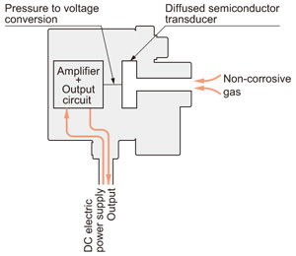
Pressure Sensor
Structure of electronic pressure sensor
For non-corrosive gases
The diffused semiconductor
transducer converts pressure into an
electrical signal, which is then
processed by an amplifier and an
output circuit

Slide 5
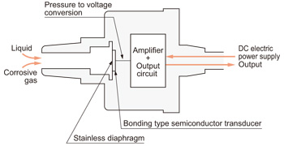
Pressure Sensor
Structure of electronic pressure sensor
For others gases & liquids
The pressure is applied to a stainless
diaphragm, whose distortion is
converted by a bonding type
semiconductor transducer, bonded at the back of the diaphragm, into an electrical signal. This signal is then
processed by an amplifier and an output. circuit.

Slide 6

Pressure Sensor
history

Slide 7
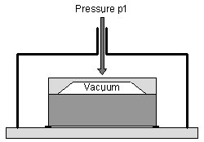
Pressure Sensor
Types of Pressure Measurements
Absolute pressure sensors measure the pressure relative to a reference chamber (nearly vacuum). Absolute pressure is referred to the vacuum of free space (zero pressure).
In practice absolute piezoresistive
pressure sensors measure the pressure
relative to a high vacuum reference sealed
behind its sensing diaphragm.
The vacuum has to be negligible
compared to the pressure to be measured.

Slide 8
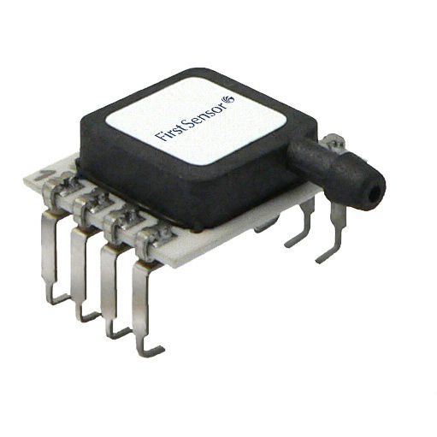
Pressure Sensor
Types of Pressure Measurements
Example Absolute pressure sensors are used to measure atmospheric pressure barometers or altimeters. For these applications special barometric pressure ranges are offered, e.g. from 600...1100 mbar or 800...1100 mbar. (product examples: (HDA)

Slide 9
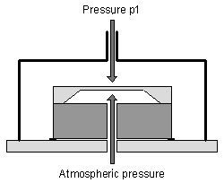
Pressure Sensor
Types of Pressure Measurements
Gage pressure sensors is measured relative to the ambient atmospheric pressure. The average atmospheric pressure at sea level is 1013.25 mbar. Changes of the atmospheric
pressure due to weather conditions or altitude directly influence the output of a gage pressure.

Slide 10
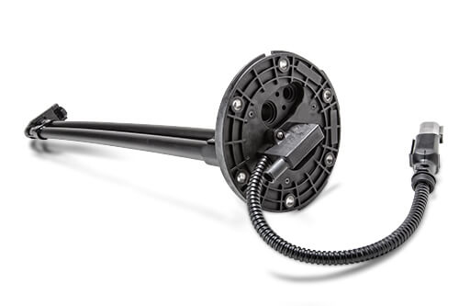
Pressure Sensor
Types of Pressure Measurements
Gage pressure sensors higher than ambient pressure is referred to as positive pressure. If the measured pressure is below atmospheric pressure it is called negative or vacuum gage pressure. In general a vacuum is a volume of space that is essentially empty of matter.
Example (SSI)

Slide 11
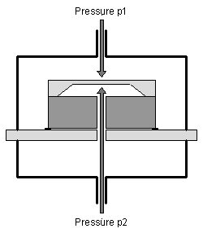
Pressure Sensor
Types of Pressure Measurements
Differential pressure sensors is the difference between any two process pressures p1 and p2. Therefore, differential pressure sensors must offer two separate pressure ports with tube or threaded connections

Slide 12
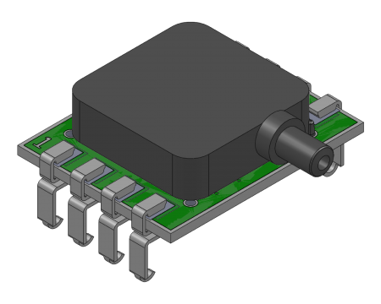
Pressure Sensor
Types of Pressure Measurements
Differential pressure sensors First Sensor's amplified pressure sensors are able to measure positive and negative pressure differences, i.e. p1>p2 and p1<p2.
Example (HCLA)

Slide 13
Pressure Sensor
Testing Pressure Sensor

Slide 14
Thank You

